Slide 1

June 2020
Airport Stakeholder Meeting

Slide 2


Overview
COVID-19 Impact & Recovery
Operational Updates
Account Information
Shell Card Benefits
Referral Program
FY21 Rent
Minimum Standards & Lease Revision
T-Hangar Maintenance
Job Vacancies
Look Ahead / Questions

Slide 3
COVID-19
Impacts
CARES Act grant
Current status

Slide 4
Operational Updates
Taxiway seal coat project
New self service POS machine
Gate 3 relocation & fence project
Terminal site work / design

Slide 5
Account Management
Keep information up to date (e.g., physical address, credit card on file)
Preference for paper or email statements
Notify us about aircraft changes
Flying club requirements

Slide 6
Shell Card Benefits
Not a credit card
Charge all fuel and rent to single account
Additional -$.05 off per gallon fuel
Applications available in terminal building
  Online: https://www.shellaviationcards.com/country/usa/Shell_Select_Application.pdf

Slide 7
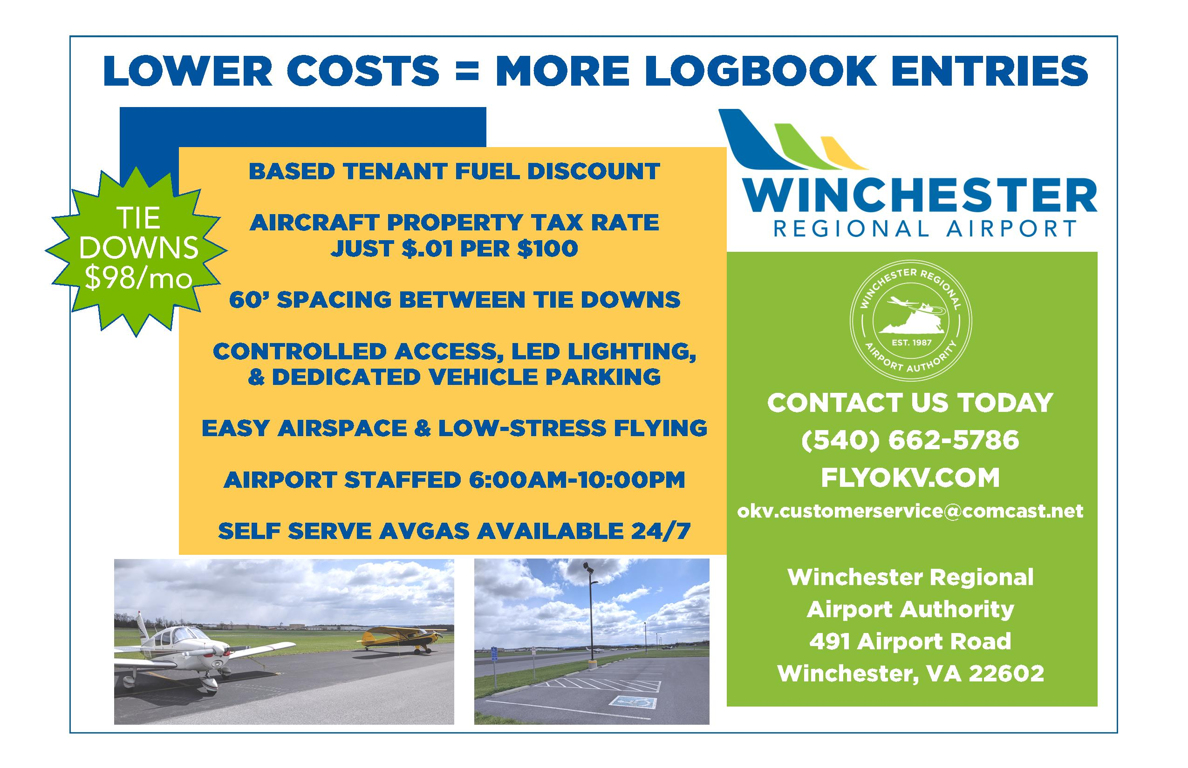
Referral Program
$75 account credit with any new tie down tenant who stays 2 months
$150 max

Slide 8
FY21 Rent
No rent adjustment in July; Authority concurred with proposal to defer any rent escalation for at least 6 months

Slide 9
Minimum Standards/Lease Revision
Authority committee is working to revise the Minimum Standards & Rules and Regulations (2009), and tie down and t-hangar lease agreements
Committee will meet at 4:00 PM prior to regularly scheduled Authority business meetings
Implementation goal: November 2020

Slide 10
T-hangar Maintenance
On June 22nd, we will begin preventive maintenance inspections in all t-hangars
Primary focus is condition of cables, motor, and door

Slide 11
Job Vacancies
2 x Flightline Technicians (1 at future date)
  Flyokv.com
  Governmentjobs.com

Slide 12
LOOK AHEAD
Personal property tax focus
Rusty Pilots, FAAST Seminars this fall
All hats/shirts $10
Wings & Wheels 2021
Follow us on Facebook and Instagram

